Slide 1






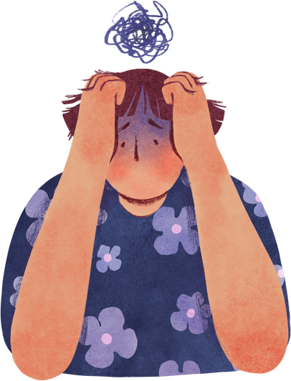
Impact of Sleep on Lifestyle and Health

Slide 2

Objectives
Modern lifestyles often compromise sleep, leading to stress and health problems.
Understand sleep patterns.
Study the relationship between sleep and stress.
Analyze lifestyle factors affecting sleep.
Investigate the impact on cardiovascular health.
Examine the role of sleep disorders.

Slide 3
Dataset Overview
Age
Gender
Occupation
Sleep Duration
Quality of Sleep
Stress Level
Physical Activity
Daily Steps
BMI Category
Blood Pressure
Sleep Disorder
374 individuals
13+ features

Slide 4
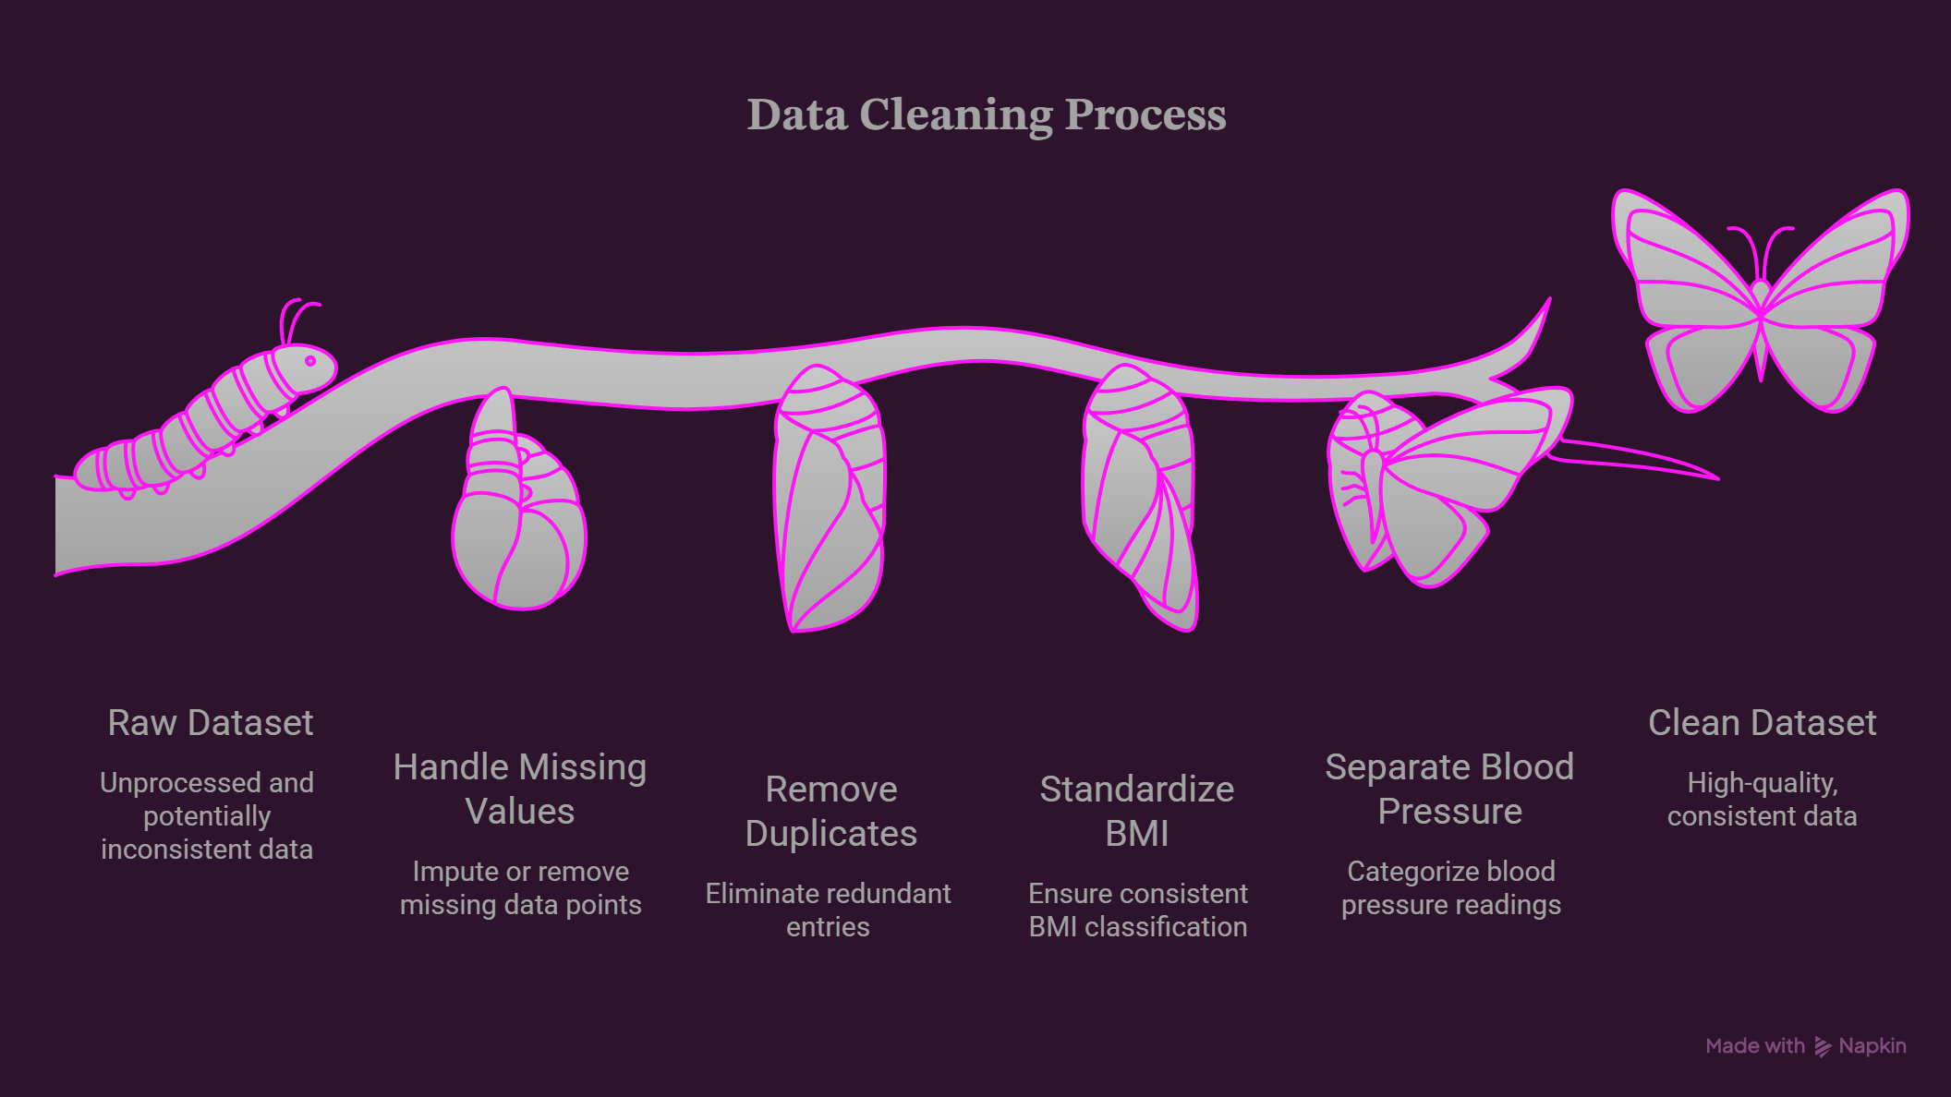
Data Cleaning

Slide 5
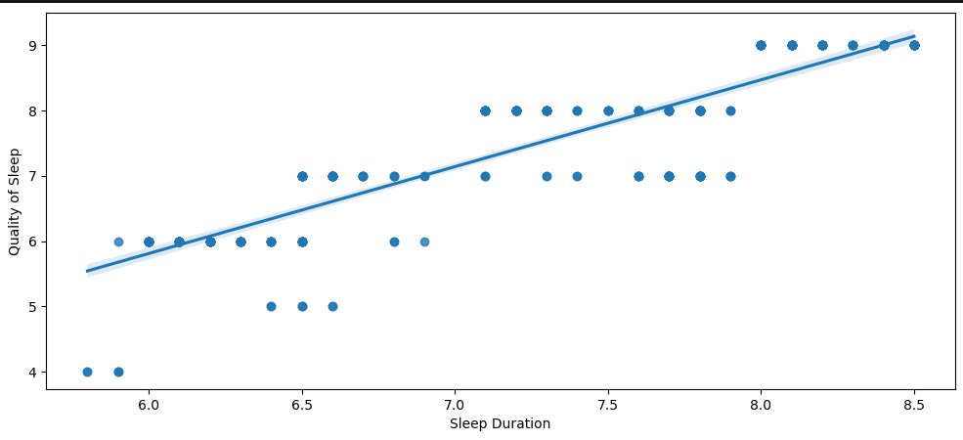
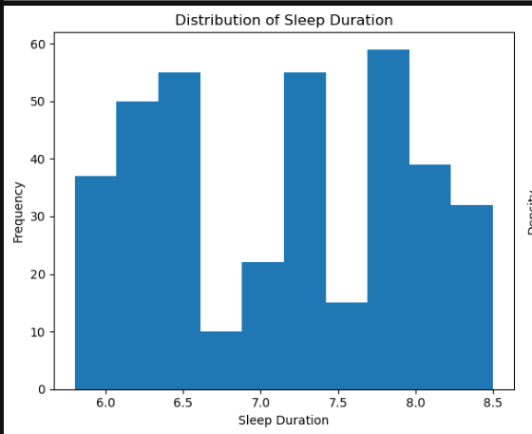
Understanding Sleep Patterns
Key Finding:- Individuals sleeping longer generally experience better quality sleep.

Slide 6
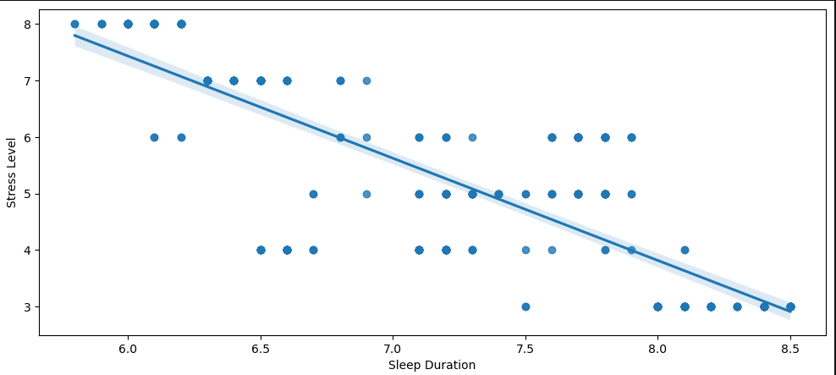
Stress and Sleep
More Sleep
Lower Stress
Key Finding:- Stress level is strongly negatively correlated with sleep quality and duration.

Slide 7
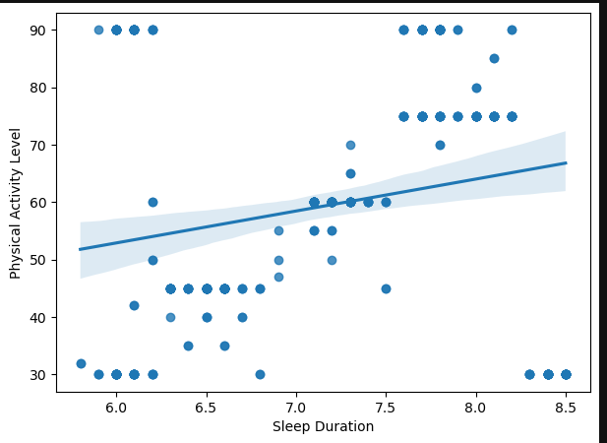
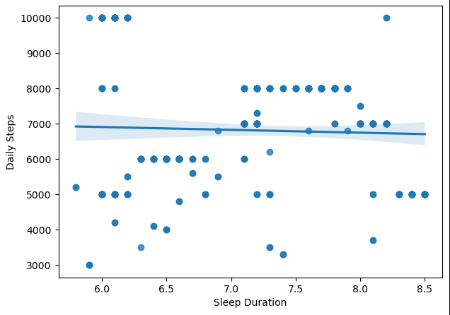
Lifestyle Factors

Slide 8
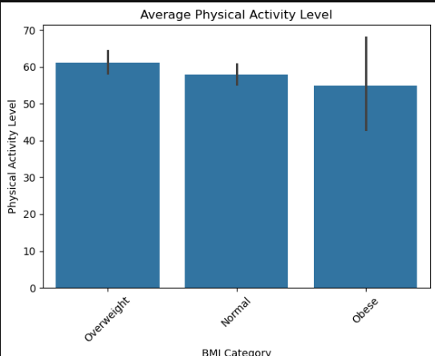
Lifestyle Factors
Adequate Sleep
More Activity
More Daily Steps
Healthy BMI

Slide 9
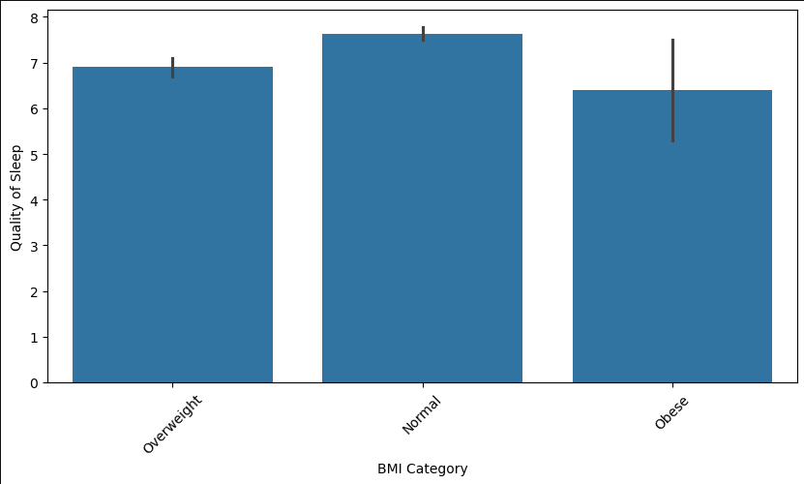
BMI and Cardiovascular Health

Slide 10
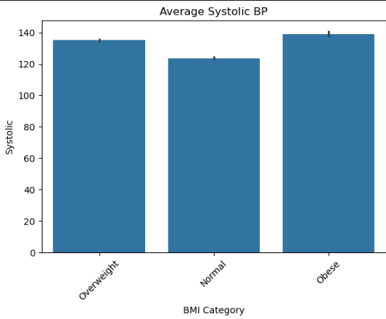
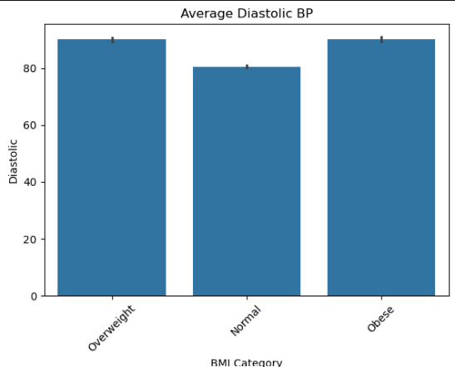
BMI and Cardiovascular Health
Healthy BMI
Lower Blood Pressure
Better Cardiovascular Health

Slide 11
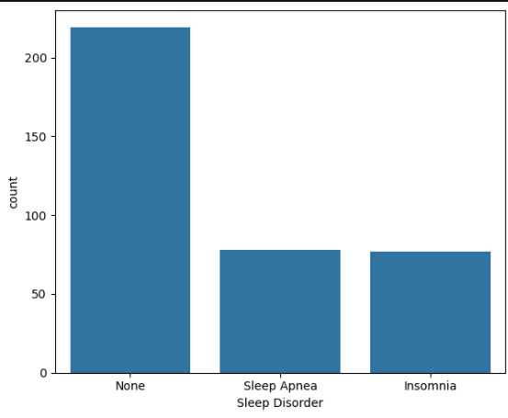
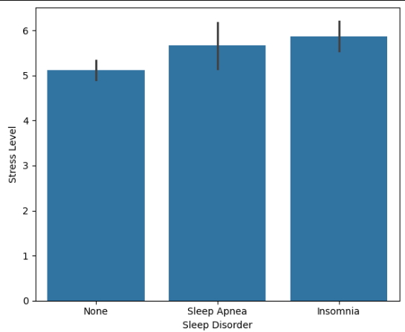
Sleep Disorders

Slide 12
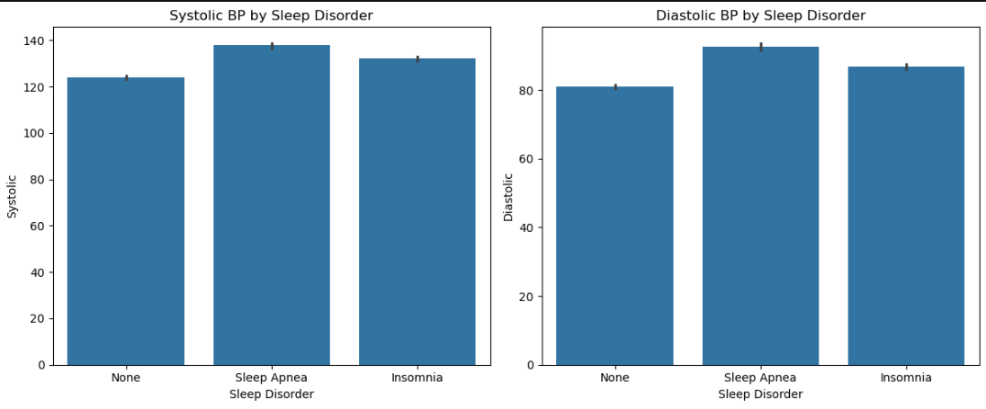
Sleep Disorders
Stress Poor Sleep Sleep Disorders Elevated Blood Pressure

Slide 13
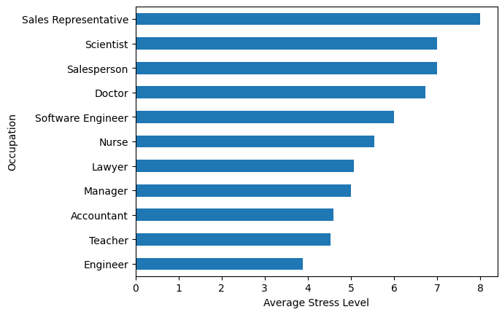
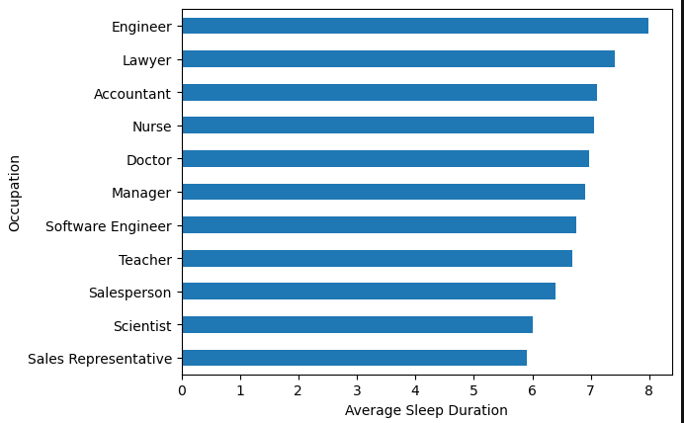
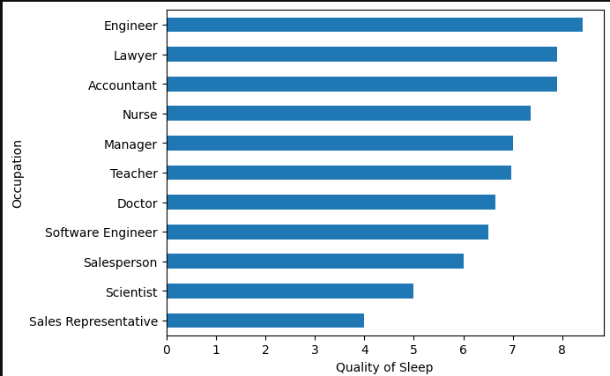
Occupation and Demographics
Occupation analysis

Slide 14
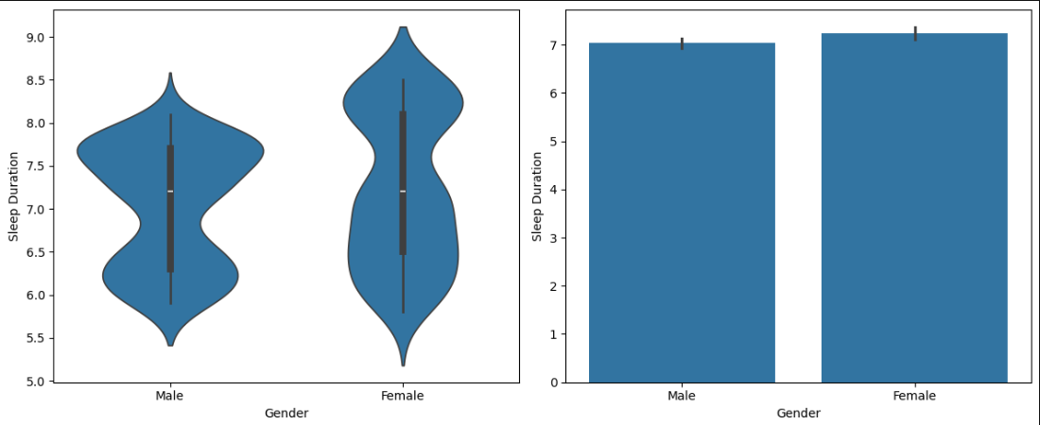
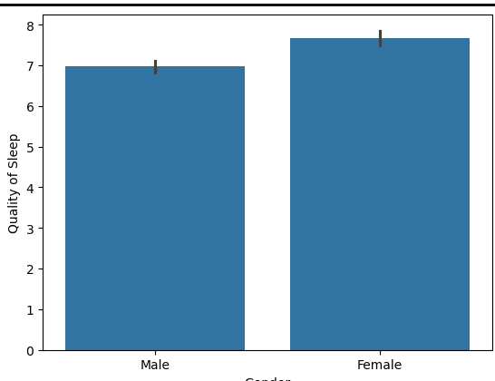
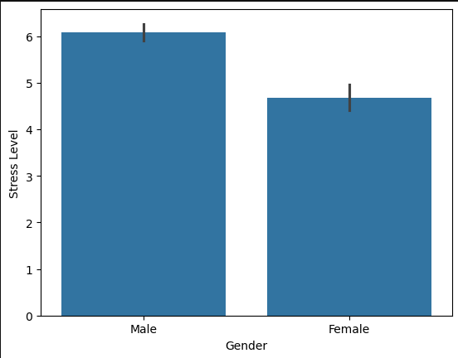

Gender analysis

Slide 15
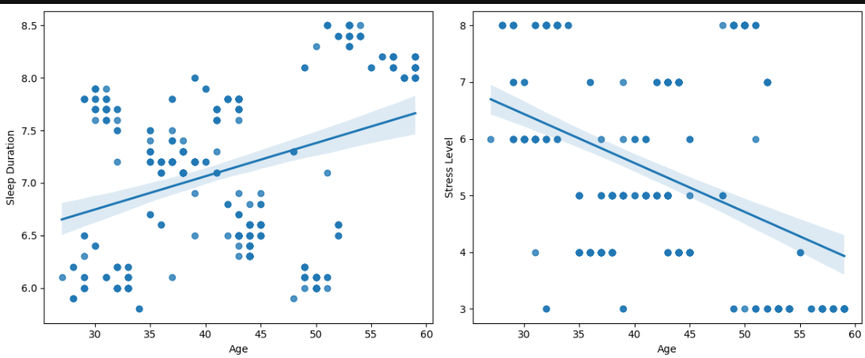
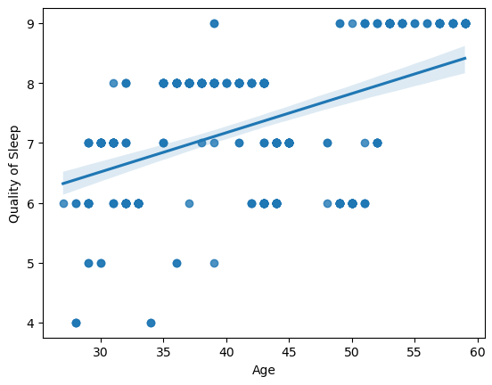
Different occupations and demographic factors influence stress and sleep behavior.
Age analysis

Slide 16
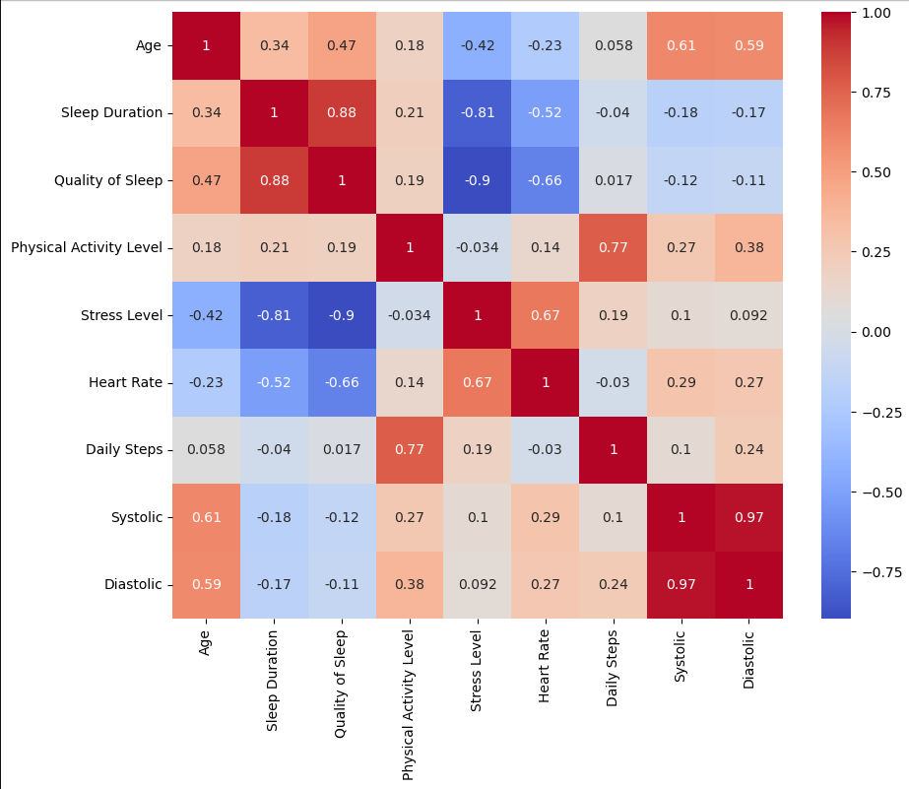
Correlation Heatmap
Strong Positive
Sleep Duration ↔ Quality of Sleep (0.88)
Physical Activity ↔ Daily Steps (0.77)
Strong Negative
Stress ↔ Quality of Sleep (-0.90)
Stress ↔ Sleep Duration (-0.81)
Positive
Stress ↔ Heart Rate (0.67)

Slide 17
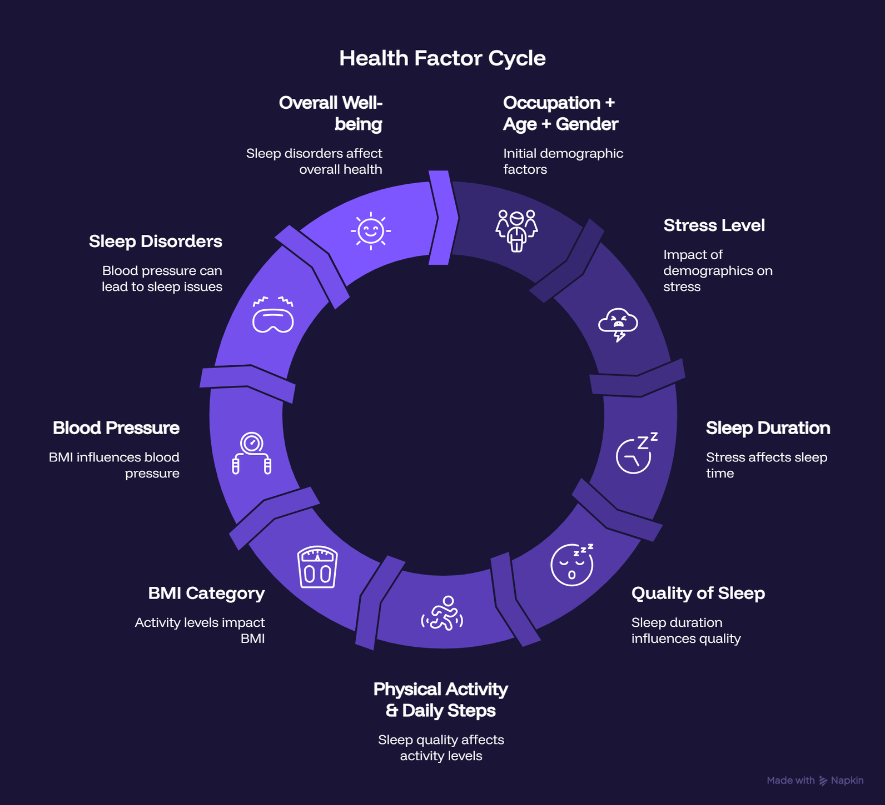
Interrelationship Diagram

Slide 18
Conclusions
Better sleep improves sleep quality.
Stress negatively affects sleep.
Physical activity contributes to healthier sleep and BMI.
Healthy BMI supports cardiovascular health.
Sleep disorders are associated with elevated stress and blood pressure.
Occupation and demographic factors indirectly affect sleep.
Sleep is interconnected with nearly every aspect of health.

Slide 19
Final Takeaway
SLEEP IS NOT MERELY A PERIOD OF REST BUT A FOUNDATION OF PHYSICAL, MENTAL, AND CARDIOVASCULAR WELL-BEING. MAINTAINING HEALTHY SLEEP HABITS, ALONG WITH REGULAR PHYSICAL ACTIVITY AND EFFECTIVE STRESS MANAGEMENT, IS ESSENTIAL FOR IMPROVING OVERALL QUALITY OF LIFE.

